Slide 1
Timer/Counter-LPC2148

Slide 2
Features
A 32-bit Timer/Counter with a programmable 32-bit Prescaler.
• Counter or Timer operation
• Up to four 32-bit capture channels per timer, that can take a snapshot of the timer value when an input signal transitions. A capture event may also optionally generate an interrupt.
• Four 32-bit match registers that allow:
– Continuous operation with optional interrupt generation on match.
– Stop timer on match with optional interrupt generation.
– Reset timer on match with optional interrupt generation.
• Up to four external outputs corresponding to match registers, with the following capabilities:
– Set low on match.
– Set high on match.
– Toggle on match.
– Do nothing on match.

Slide 3
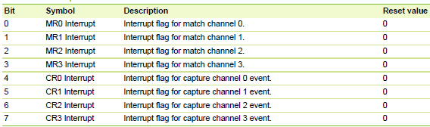
Programmable Timer Registers
IR Interrupt Register-
The IR can be written to clear interrupts.
The IR can be read to identify which of eight possible interrupt sources are pending.

Slide 4
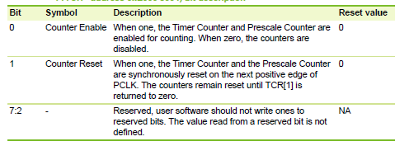
TCR Timer Control Register-
The TCR is used to control the Timer Counter functions.
The Timer Counter can be disabled or reset through the TCR.

Slide 5
TC Timer Counter.
The 32-bit TC is incremented every PR+1 cycles of PCLK.
The TC is controlled through the TCR.
The 32-bit Timer Counter is incremented when the Prescale Counter reaches its terminal count.

Slide 6
PR Prescale Register-
The 32-bit Prescale Register specifies the maximum value for the Prescale Counter

Slide 7
PC Prescale Counter
The 32-bit PC is a counter which is incremented to the value stored in PR. When the value in PR is reached, the TC is incremented and the PC is cleared.
The Prescale Counter is incremented on every PCLK. When it reaches the value stored in the Prescale Register, the Timer Counter is incremented and the Prescale Counter is reset on the next PCLK.
This causes the TC to increment on every PCLK when PR = 0, every 2 PCLKs when PR = 1, etc.

Slide 8
Match registers
Match Registers (MR0 - MR3)
The Match register values are continuously compared to the Timer Counter value. When the two values are equal, actions can be triggered automatically.
The action possibilities are to generate an interrupt, reset the Timer Counter, or stop the timer.
Actions are controlled by the settings in the MCR register.

Slide 9
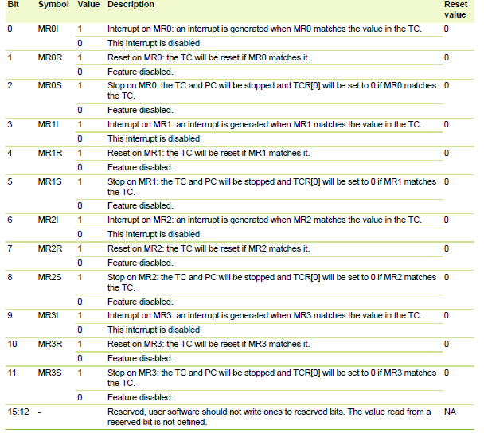
MCR Match Control Register-
The MCR is used to control if an interrupt is generated and if the TC is reset when a Match occurs.

Slide 10
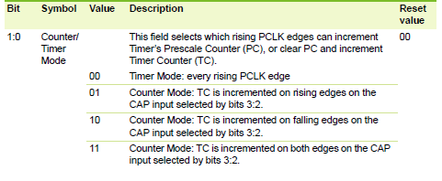
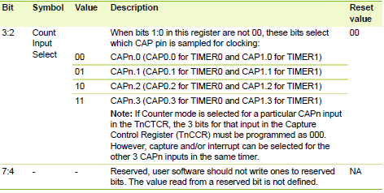
CTCR Count Control Register-
The CTCR selects between Timer and Counter mode, and in Counter mode selects the signal and edge(s) for counting.

Slide 11
Computation
Count=(PCLK*basic time delay)-1
basetimevalue=1ms
count(PR)=(pclk*basetimevalue)-1
=(12MHz *0.001 sec)-1
= 11999
T0PR=PRESCALER;//11999
T0MR0=DESIRED_COUNT; //interrupt every 1 sec for interval = 1000
T0MCR=3;//interrupt and reset when counter=match
T0TCR=2; // reset timer counter
T0TCR = 0x01; // start timer
T0IR=0x01; // clear flag

Slide 12
#include <LPC21xx.H>
#define DESIRED_COUNT 1000 // for 1sec
#define PRESCALER 11999
void InitTimer0(void);
void InitTimer0(void)
{
T0PR=PRESCALER;
T0MR0=DESIRED_COUNT; //interrupt every 1 sec for interval = 1000
T0MCR=3; //interrupt and reset when counter=match
T0TCR=2; // reset timer
}
int main (void)
{
PINSEL0 = 0X00000000 ; // Configure P0.16-p0.23 as GPIO
IODIR0=0X00FF0000;
InitTimer0(); // initialise timer0 -
T0TCR = 0x01; // start timer
while(1)
{
while(!( T0IR==0x01)); // wait for overflow
T0IR=0x01; // clear flag
IOCLR0=0X00FF0000; // turn on led
while(!( T0IR==0x01));
IOSET0=0X00FF0000; // turn off flag
T0IR=0x01;
}
}

Slide 13
REFERENCES
UM10139 Volume 1: LPC214x User Manual Rev. 02 — 25 July 2006 User manual LPC214x

Slide 14
THANK YOU

